Slide 1
PyData: Monte Carlo Modelling
17th April 2024

Slide 2
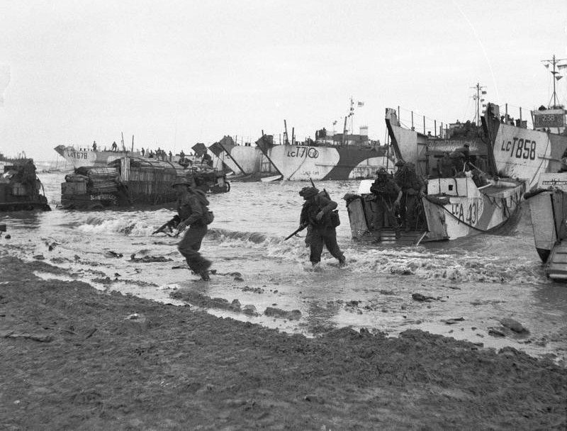
This Photo by Unknown Author is licensed under CC BY-SA

Slide 3
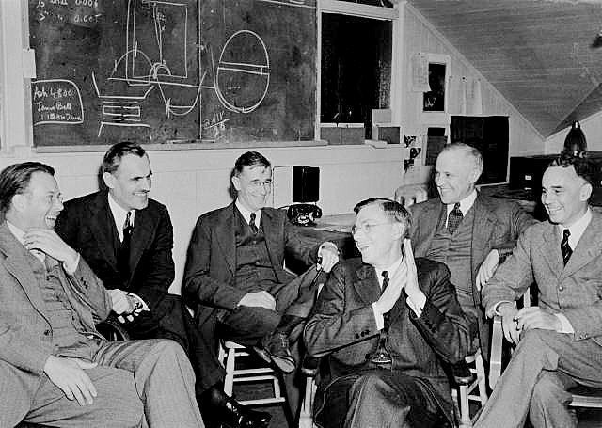
This Photo by Unknown Author is licensed under CC BY-SA

Slide 4
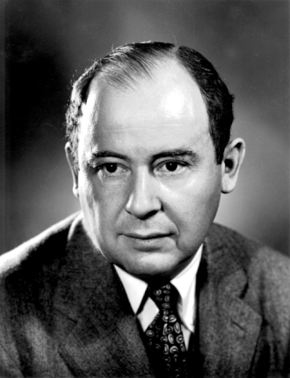
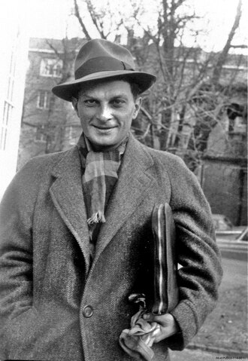
Jon von Neumann
Stanislaw Ulam

Slide 5


Slide 6

This Photo by Unknown Author is licensed under CC BY-NC

Slide 7
Richard Warburton

Slide 8

Richard Warburton
Data analyst & scientist (19 years experience)
Specialize in:
Helping people understand and analyse data
Helping people understand complex processes
Communicate insights and findings
Driving change and transformation programmes
Communication, presenting and public speaking

Slide 9
S
(X₁,…,X_{n}
,p₁,…,p_{m} )
Where: n>0, m>=0
X_{i} ~ D

Slide 10
S
(X₁,…,X_{n}
,p₁,…,p_{m} )
= State of System
= Observation

Slide 11
S
(1)
(1)
(X₁,…,X_{n}
,p₁,…,p_{m} )
= Observation 1

Slide 12
S
(2)
(2)
(X₁,…,X_{n}
,p₁,…,p_{m} )
= Observation 2

Slide 13
S
(k)
(k)
(X₁,…,X_{n}
,p₁,…,p_{m} )
= Observation k

Slide 14
S
(X₁,…,X_{n}
,p₁,…,p_{m} )
k
Set of K System Observations

Slide 15
Set of K System Observations
Analyse system behaviour
Generate intuition and understanding
Make predictions
Quantify the unknown or difficult to calculate
Communicable output

Slide 16


Slide 17
Snakes & Ladders

Slide 18
Snakes Pythons & Ladders

Slide 19
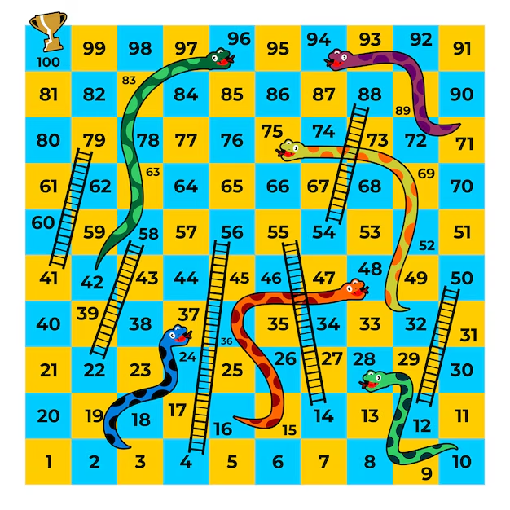

Slide 20
S
X_{i}
P
O_{k}
Game of S&L
Uniform(6)
The Board (Dict)
# Throws

Slide 21
Play game k times:
Start at:
square = 0
throws = 0
While square < 100
Roll a uniform die (v)
Increment throws by 1
square = square + (v)
square = dict[square]
Store result for the game

Slide 22
Finance Example

Slide 23
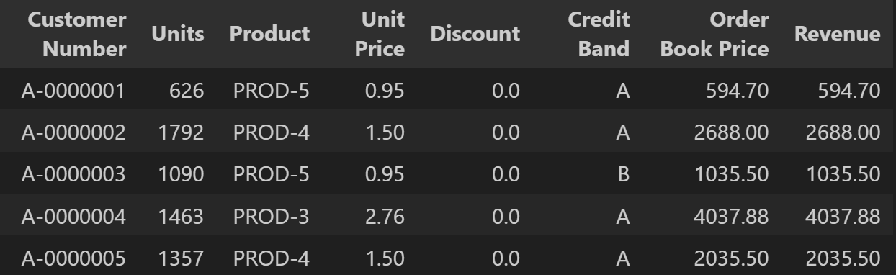
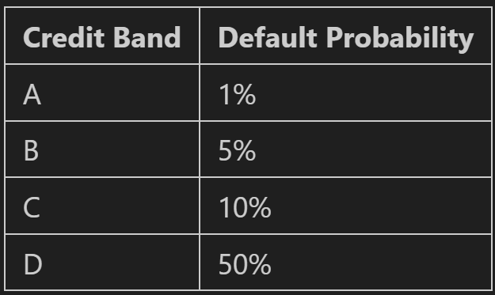
Monthly Order Book

Slide 24
Monte Carlo Modelling
Understanding through iteration
Flexible, versatile and powerful tool
Explains complex models where random elements interact
Risk mitigation & decision support
Comprehensible process and results
Insightful visualisation

Slide 25
References / Further Reading
https://en.wikipedia.org/wiki/Stanis%C5%82aw_Ulam
https://en.wikipedia.org/wiki/John_von_Neumann
https://en.wikipedia.org/wiki/Monte_Carlo_method

Slide 26
Other Uses

